Slide 1
Session-wise topics
Session – I
Field Attributes
  No Input Field
  No Change Field
  Mandatory Field
  Re-key Field
Session – II
Field Attributes
  Associated Version
  Next Version
  Zero Authorization Version
  STP

Slide 2
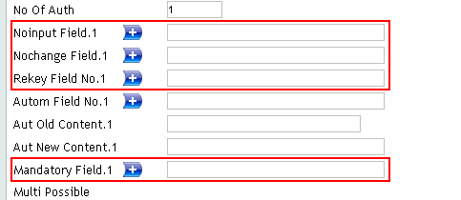
Various Field Attributes
No Input – User is not allowed to input data
No Change – User is allowed only once to input data
Mandatory – User has to compulsorily input data
Re-key – Authorizer has to input data, while authorizing

Slide 3
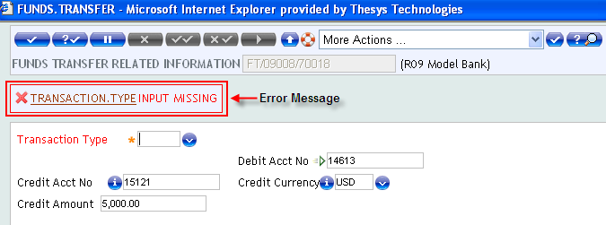
No Input
Prevent users from entering a value in this field
Fields appears grey when displayed
It is a Multi-value field
Default a value, while choosing a mandatory field as NOINPUT. Else error will appear as shown

Slide 4
No Input
Create a version for account and set the field ‘MNEMONIC’ as No Input field

Slide 5
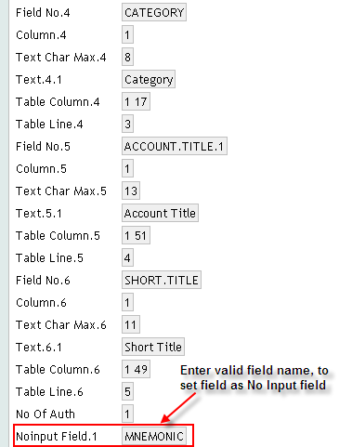

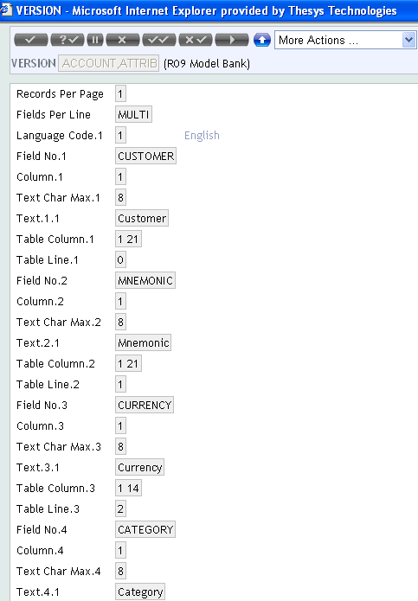
No Input

Slide 6
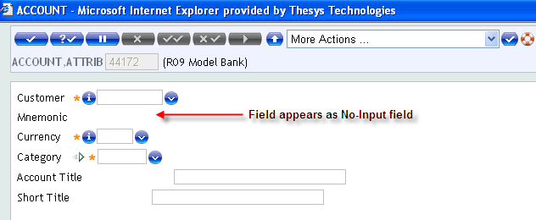
No Input
At input stage, Version appears as shown

Slide 7
No Change
After record authorization
  Prevent users from changing the value of field
  Fields appears grey
  NOCHANGE fields becomes NOINPUT fields

Slide 8
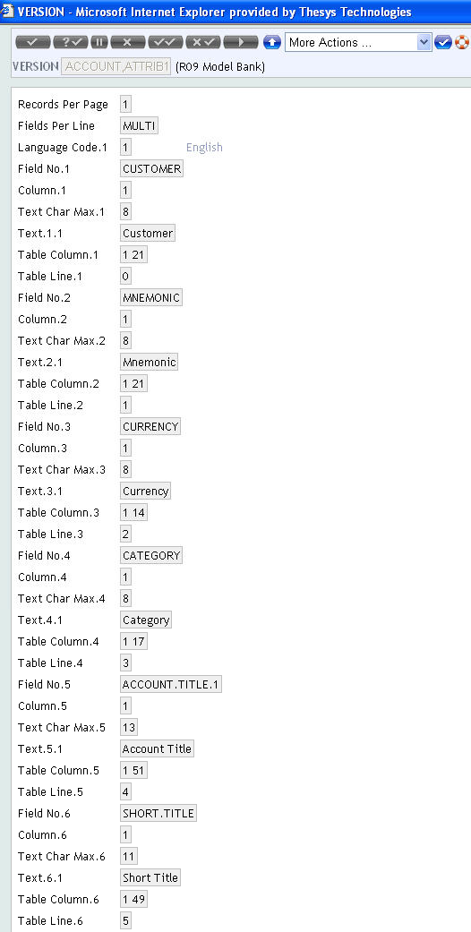
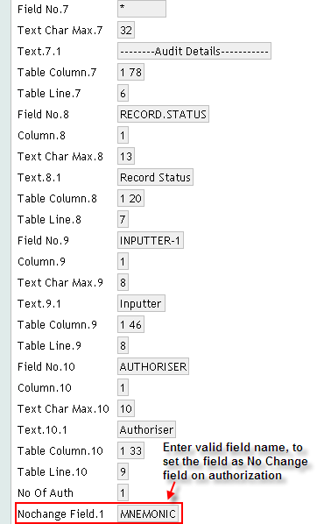
No Change
Create a version for account module as shown

Slide 9
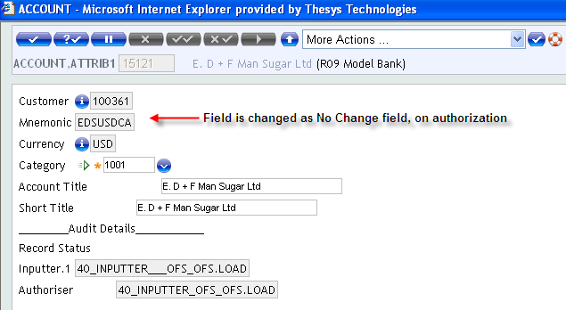
No Change
On authorization, field set to ‘No Change’ attribute appears as shown

Slide 10
Mandatory Field
Forces data input in a field declared as optional by the Application
Non-mandatory field can be made mandatory, vice versa is not possible
Use the field ‘Mandatory Field’ of Version

Slide 11
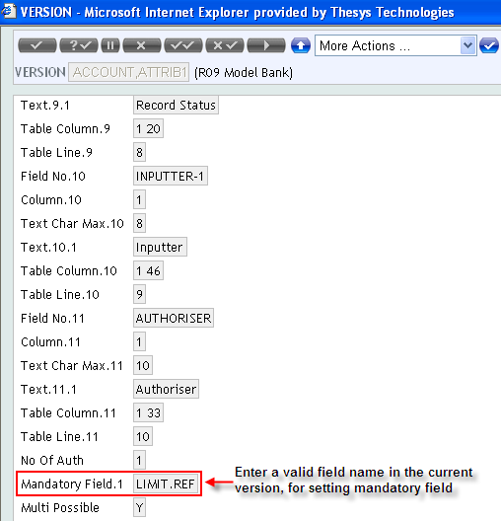
Mandatory Field
Create a version for account module, setting LIMIT.REF field as mandatory

Slide 12
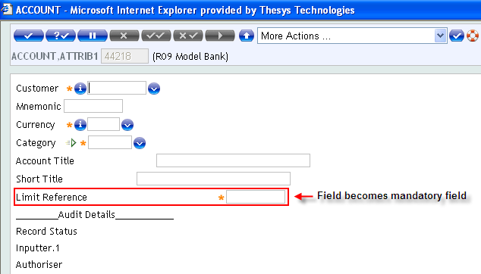
Mandatory Field
At input stage, the field LIMIT.REF becomes mandatory

Slide 13
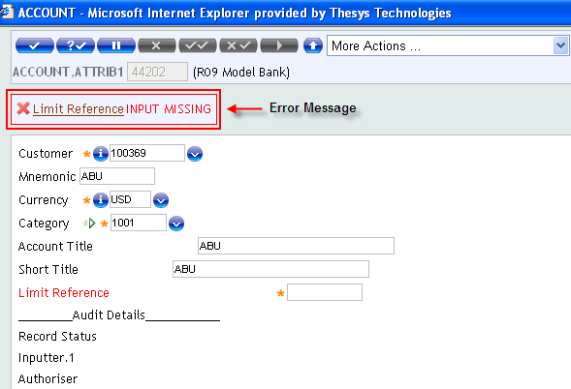
Mandatory Field
Error appears as shown on committing record, when field is not input

Slide 14
Workshop
Create a version for Customer application and set the following attributes
  No Input – Account Officer
  No Change – Short Name
  Re-key field – Mnemonic
  Mandatory – Issue Cheques

Slide 15
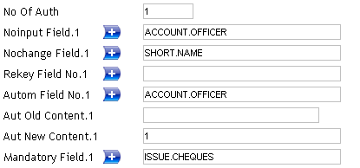
Solution
Create a version for Customer application
Add OVERRIDE field to the customer version

Slide 16
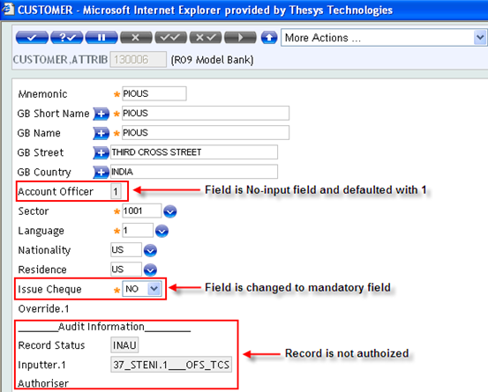
Solution
Output of enquiry appears as shown

Slide 17
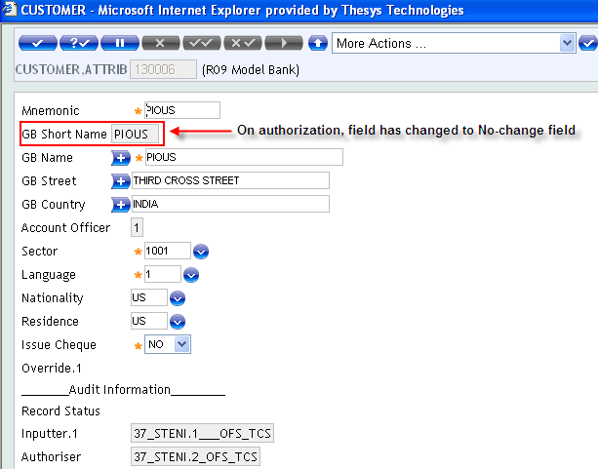
Solution

Slide 18
Associated Version
Holds a list of Versions associated with the current Versions
Used as alternative views of contract input in T24.
Appear "behind" the main version
Accessed by "tabs

Slide 19
Associated Version
Create a version for account application
Attach another version of the account application in Assoc Version field

Slide 20
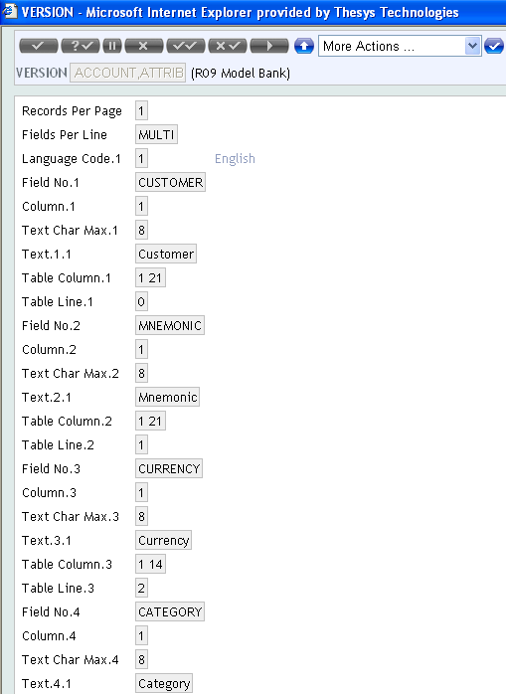
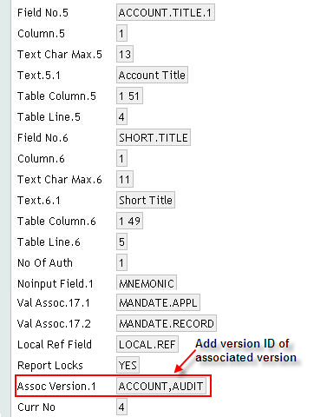
Associated Version

Slide 21
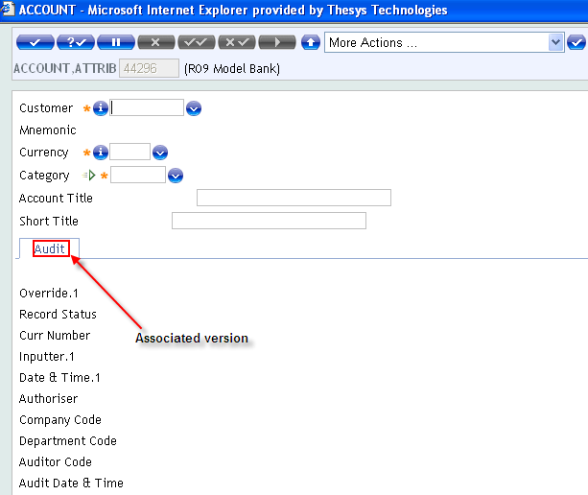
Associated Version
The attached associated version appears as tab

Slide 22
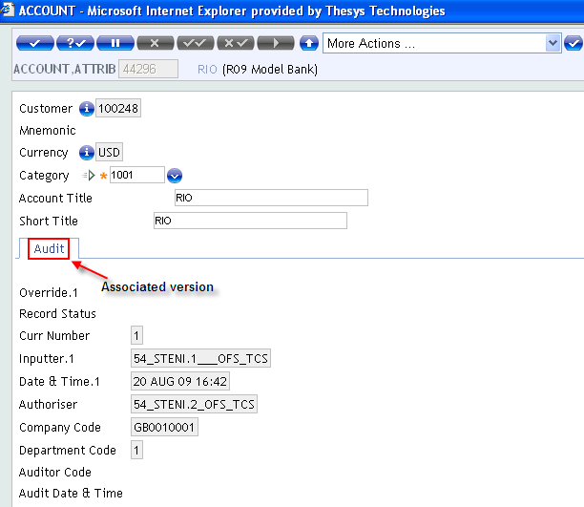
Associated Version
On authorization, details input in main version will default values in associated version

Slide 23
Next Version
Specify the name of version to be launched, on validation of current version
E.g., On validation of Customer version, invoke Account version

Slide 24
Next Version
Create a version for account application
Attach the ID of next version to-be-invoked (eg. FT,DETAILS) in the field ‘Next Version’

Slide 25
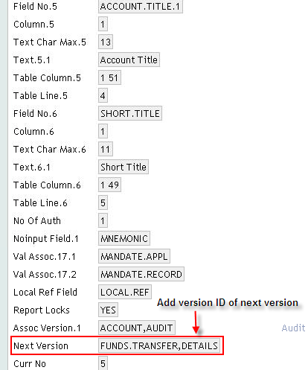
Next Version

Slide 26
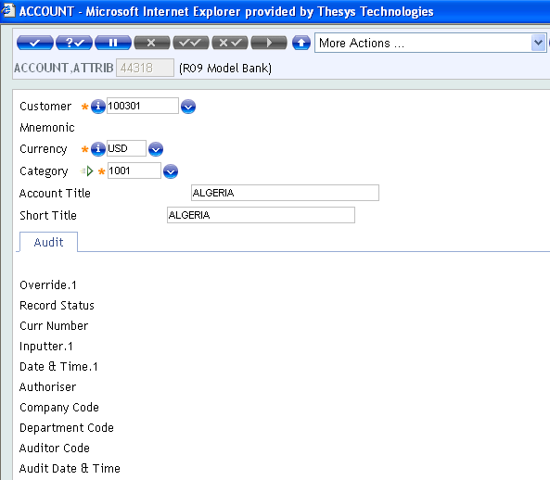
Next Version
Run the version and input Account details as shown

Slide 27
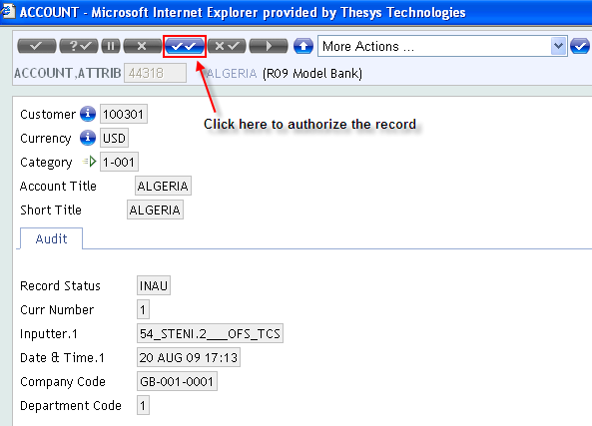
Next Version
On authorization of Account application, next ‘FT’ version is invoked as shown in next slide

Slide 28
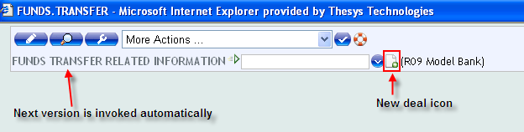
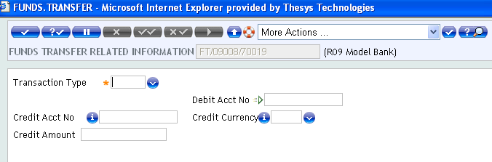
Next Version
Click on the New deal icon, to create a new record for the FT application

Slide 29
Workshop
Create a version for Customer application having
  Another Customer version containing audit details as associated version
  Account version as next version

Slide 30
Solution
Create a version for Customer application
Attach the version of Customer containing audit details as associated version
Attach the version of Account as next version

Slide 31
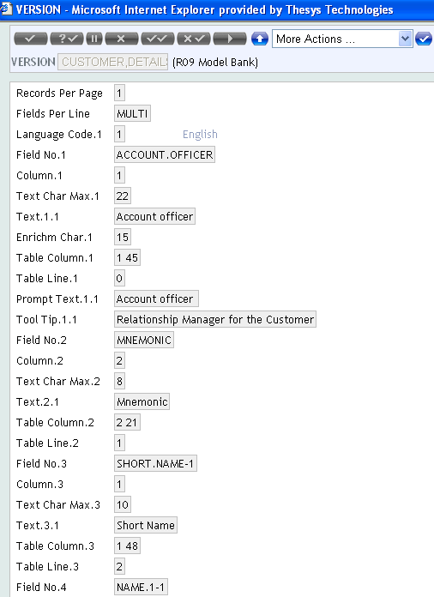
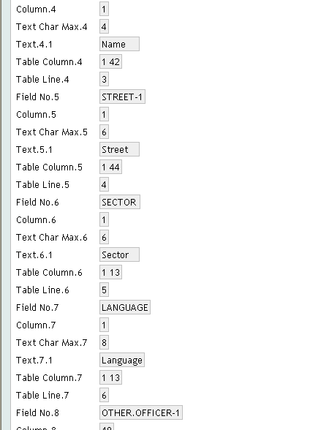
Solution

Slide 32
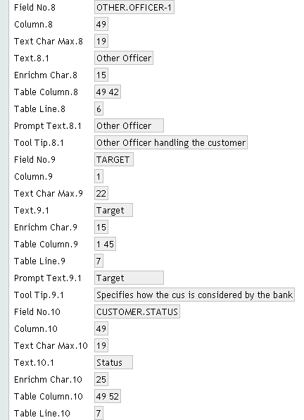
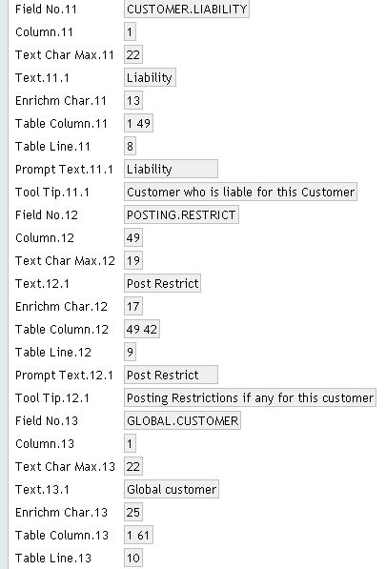
Solution

Slide 33
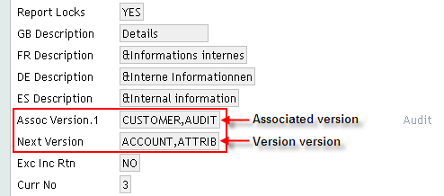
Solution

Slide 34
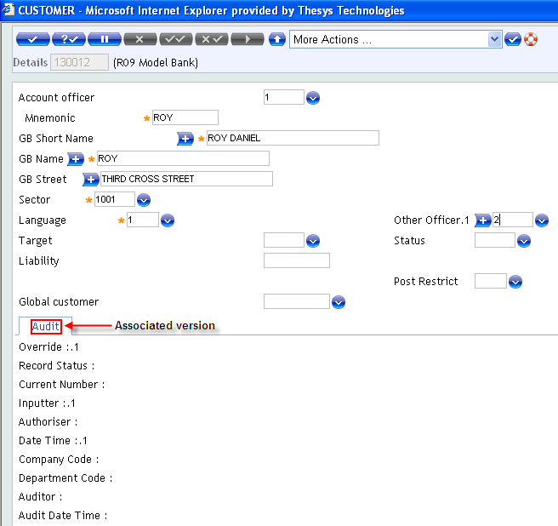
Solution
The Customer version appears as shown
The associated Customer version appears as tab

Slide 35
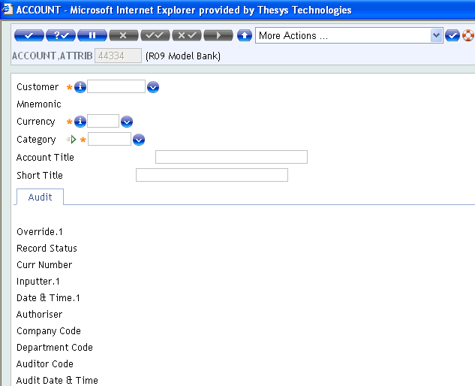
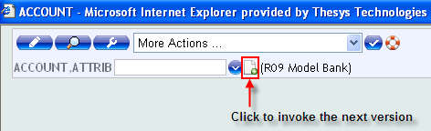
Solution
On authorization of the Customer version shown in previous slide, the next version of Account Application appears as shown

Slide 36
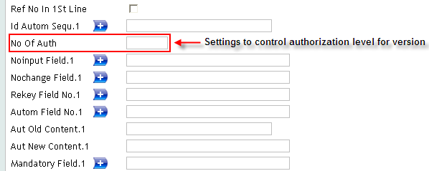
Zero Authorization Version
NO.OF.AUTH field in version is used to set number of authorizers
  0
  1
  2

Slide 37
Zero Authorization Version
Version used for authorizing must contain the ‘OVERRIDE’ field
Naming convention in T24 for zero authorizer versions is
  <application name>, E.g.: ACCOUNT, or CUSTOMER,
Versions can also be set as zero authorizer versions
  <application name>,<version name> E.g.: ACCOUNT,CLIENT

Slide 38
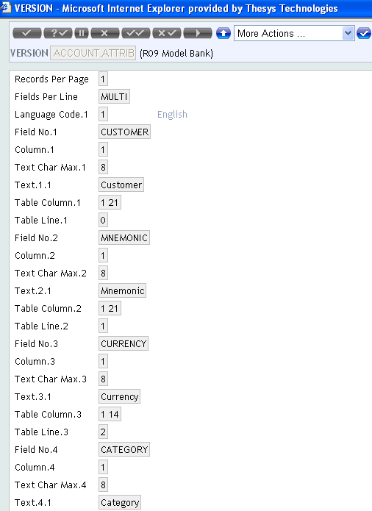
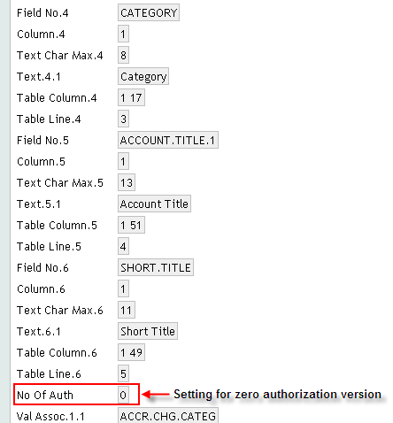
Zero Authorization Version
Create a version for Account application
‘No Of Auth’ field is set to ‘0’

Slide 39
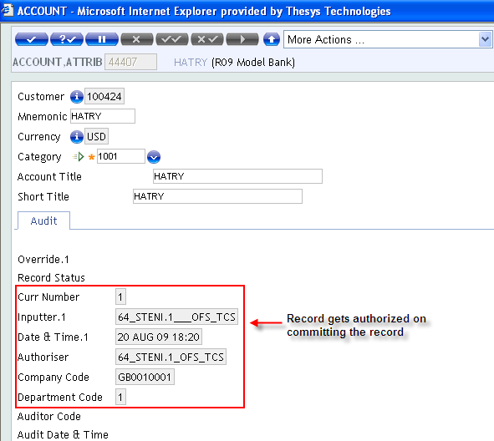
Zero Authorization Version
When field ‘No Of Auth’ is set to 0, the record status is updated as shown

Slide 40
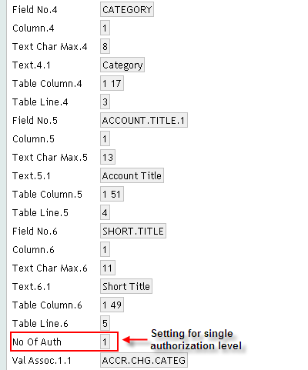
Zero Authorization Version
‘No Of Auth’ field is set to ‘1’ in the Account version

Slide 41
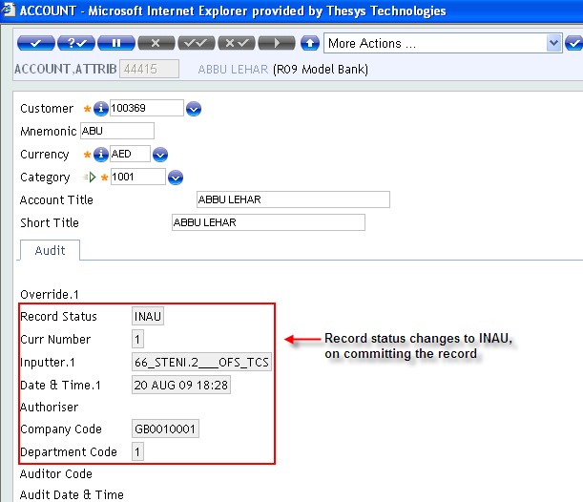
Zero Authorization Version
When field No Of Auth is set to 1, the record status is updated as shown

Slide 42
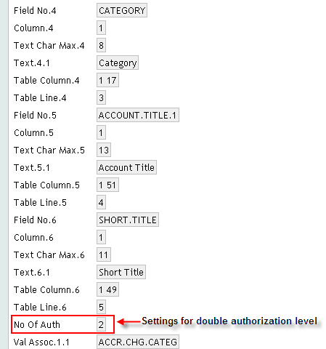
Zero Authorization Version
‘No Of Auth’ field is set to ‘2’ in the Account version

Slide 43
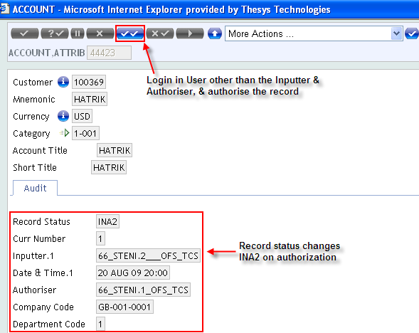
Zero Authorization Version
When field No Of Auth is set to 2, the record status is updated as shown

Slide 44
Why STP?
STP -> Straight Through Processing
User Authorization rights vary for various transactions, based on condition e.g. for a particular Sector
So condition has to be set to vary the authorization rights, based on the condition, automatically

Slide 45
Why STP?
Depending on conditions set, the NO.OF.AUTH field in the Version record has to be overridden
If STP is satisfied,
  Version becomes a “0” authorizer version for that transaction
  No actual change happens to the version record

Slide 46
How to set STP?
EB.STP.CONDITION
  Application used to define the conditions that STP must be based on
  ID – Version name
  Condition could be based on data in the application record
  Called before UNAUTH.WRITE at template level
  Routine can be attached to decide the condition

Slide 47
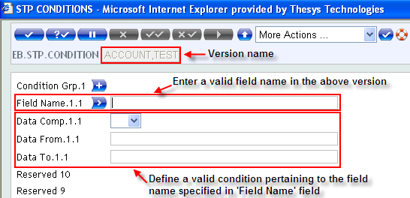
How to set STP?

Slide 48
How STP works?
Create a Version that is set to single or double authorization level
Input a transaction in the above version
When, transaction is input on a particular sector for which STP is set, transaction is authorized on committing the record
i.e. version automatically shifts to zero authorization level, when STP condition is satisfied

Slide 49
Example
Set STP for a version of Customer application that is having single authorizer level, based on condition that Customer belongs to sector 1002

Slide 50
Solution
Create a single authorizer version for Customer application

Slide 51
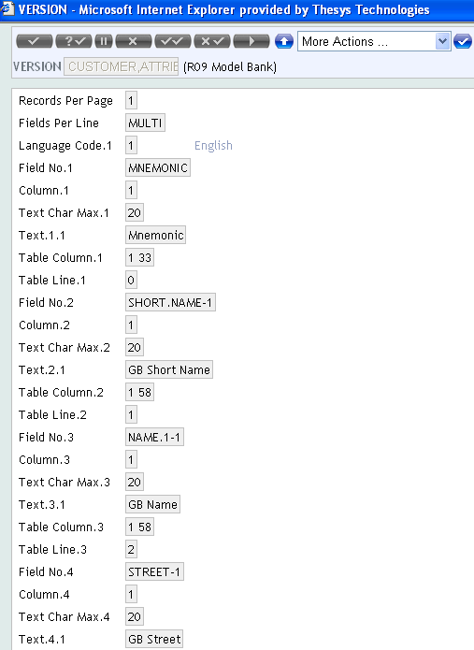
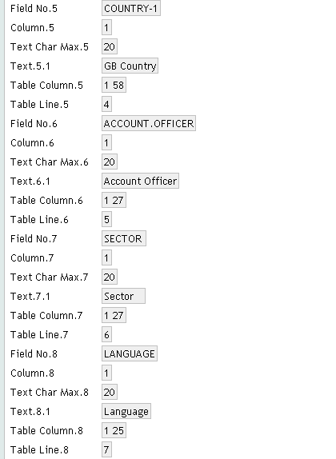
Solution

Slide 52
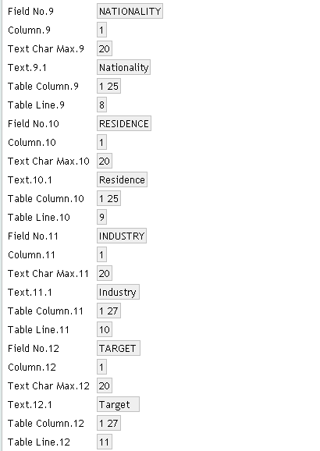
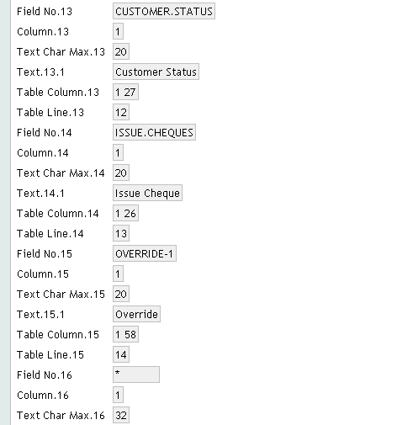
Solution

Slide 53
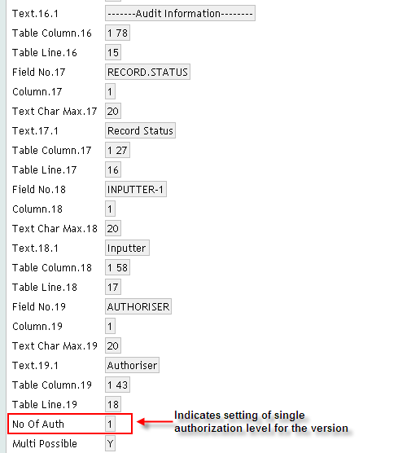
Solution

Slide 54
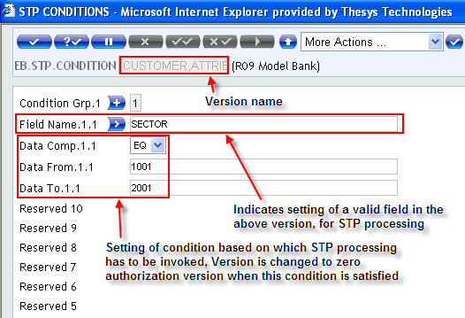
Solution
Set STP for the created Customer version

Slide 55
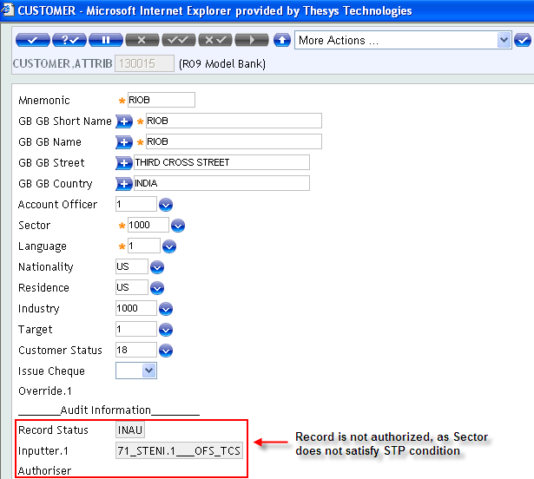
Solution
Input a transaction in the Customer version, on a condition not satisfying the condition set in STP
Check the authorization level

Slide 56
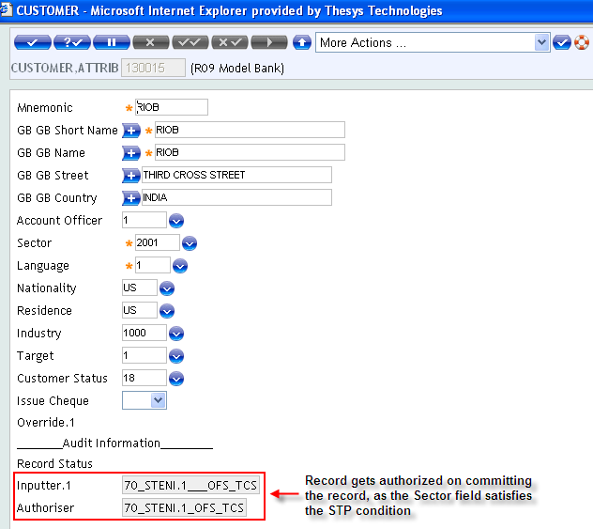
Solution
Input a transaction in the Customer version, on a condition satisfying the condition set in STP
Check the authorization level

Slide 57
Summary
We have learnt
  How to set field attributes
    No Change Field, Mandatory Field & Re-key Field & No Input Field
  How to create link between version
    Next Version & Associated Version
  About the authorization features available in version
    Zero Authorization
    Single Authorization
    Double Authorization
  How to control authorization rights for a particular version
    Straight Through Processing (STP)

Slide 58


www.capgemini.com/financialservices
Notes:
© 2006 Capgemini - All rights reserved

